Slide 1
Carbon-12
Carbon-13
¹³C
¹²C
δ¹³C (‰) =
Notes:
We can measure this, and express it with DELTA notation (CIRCLE) which is the ratio of the heavy isotope to the light isotope, relative to a standard. So in this case the more Carbon 13 in a plant or animal tissue, the higher the delta value. And the units here are parts per thousand, or PER MIL.

Slide 2

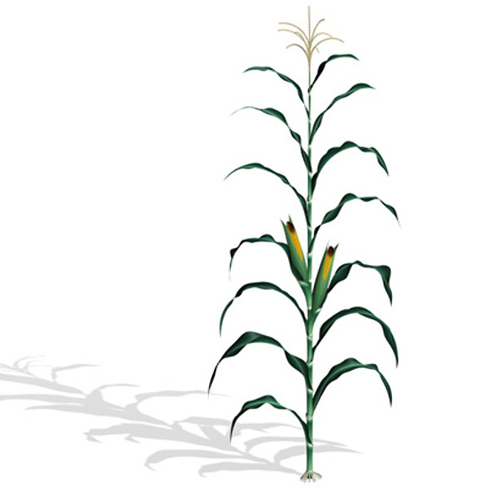
Fractionation
¹³CO₂
¹³CO₂
¹²CO₂
¹²CO₂
C3
δ¹³C
C4
-28
-13
Notes:
For example, when uptaking CO2 during photosynthesis C3 plants discriminate strongly against CO2 molecules with the heavier isotope, and so have lower d13C values (CIRCLE -28). In contract C4 plants will incorporate more Carbon 13 because of their different photosynthetic pathway and have higher values. And this differential incorporation of one particular isotope is known as fractionation.

Slide 3
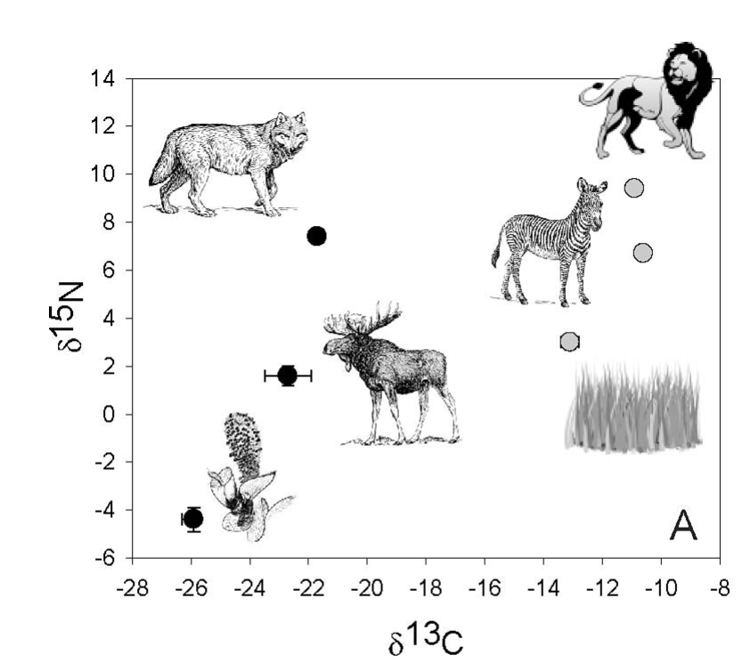
Ben-David et al. 2012

Slide 4
Hall’s Cave Sigmodon Isotopes
S.hispidus ‘bulk’ δ¹⁵N
Cal years BP
*excluded bins with <5 individuals

Slide 5
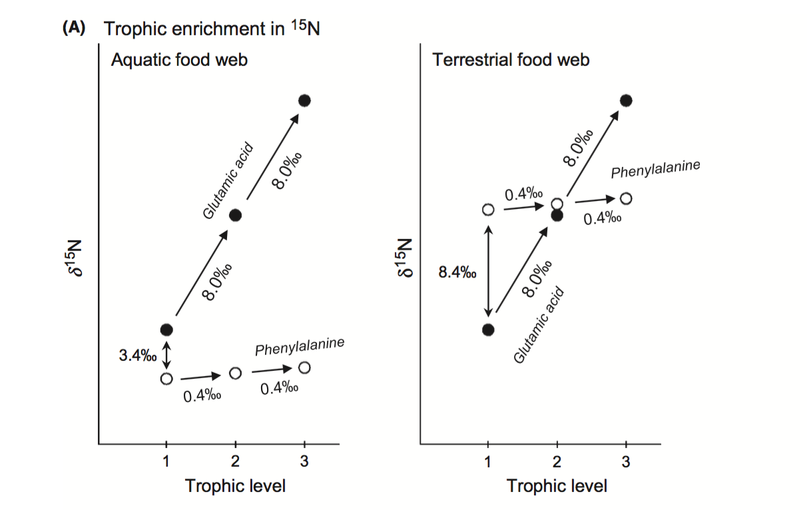
Chikaraishi et al. 2014

Slide 6
TROPHIC AA
SOURCE AA
Chikaraishi et al. 2014

Slide 7

TROPHIC AA
β
SOURCE AA
Chikaraishi et al. 2014
Notes:
BETA – difference between phe and glu at the primary producer level…

Slide 8
TROPHIC AA
TDF_{AA}
SOURCE AA
Chikaraishi et al. 2014
Notes:
Then with each increase in trophic level, glutamic acid isotope values increases substantially.

Slide 9
(δ¹⁵N_{Glu} – δ¹⁵N_{Phe} – β) TDF_{AA}
TL =
+1
Chikaraishi et al. 2014
Notes:
Then with each increase in trophic level, glutamic acid isotope values increases substantially.

Slide 11
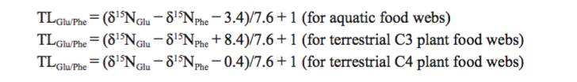
Chikaraishi et al. 2014
Notes:
The problem is, this schematic is based on studies from marine food webs…

